Slide 1
Text Analytics

Slide 2
Text Analytics
In this course, this refers to regular tasks (e.g., classification, regression…) on text data
Text data is usually referred to as unstructured data
One instance can be one sentence, one paragraph, or one document
Need to be transformed into numeric before modeling
We will explore different ways to process text data
There are other tasks on text data, e.g., summarization, translations, etc., however, they are not in the scope of our course
All the packages we use in this module are available in Azure Machine Learning and do not require manual installations
It was the best of times, it was the worst of times, it was the age of wisdom, it was the age of foolishness, it was the epoch of belief, it was the epoch of incredulity, it was the season of Light, it was the season of Darkness, it was the spring of hope, it was the winter of despair, we had everything before us, we had nothing before us, we were all going direct to Heaven, we were all going direct the other way—in short, the period was so far like the present period, that some of its noisiest authorities insisted on its being received, for good or for evil, in the superlative degree of comparison only.

Slide 3
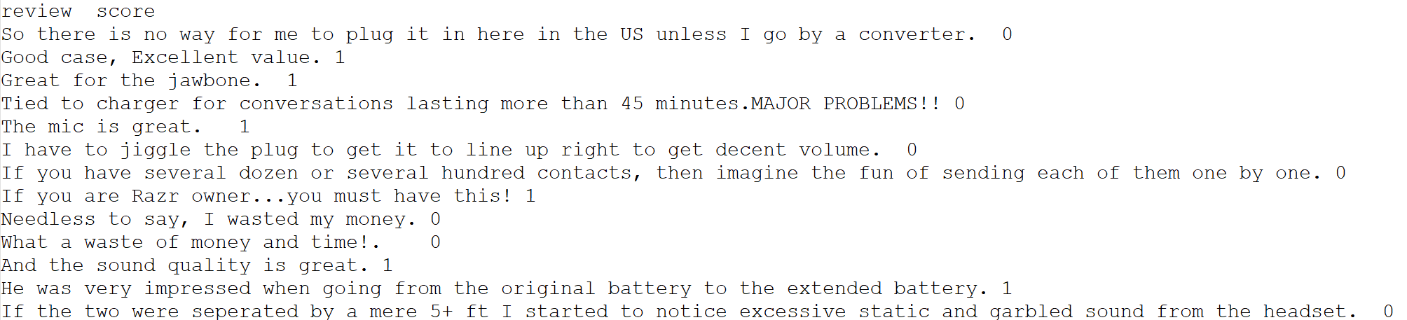
The Review Dataset
Consists of about 3000 (short) reviews collected from Amazon, IMDB, and Yelp
Each review is scored with 1 (positive) or 0 (negative). So, we model this problem as a binary classification task
As mentioned, the raw text cannot be processed by models we have learned, so they need some preprocessing

Slide 4
Methods to Transform Raw Text
We will discuss three common methods to transform raw text into representations that can be modeled by machine learning techniques
Term Frequency – Inverse Document Frequency (TF-IDF)
Word Embedding
Universal Sentence Encoder

Slide 5
Term Frequency – Inverse Document Frequency (TF-IDF)
TF-IDF is the method that represent each document in the corpus (the text dataset) as a vector of values that are calculated from
The frequency of each unique term in the current document (term frequency)
The frequency of each unique term occurring over all documents in the corpus (document frequency). The document frequency is inversed in the calculation of TF-IDF
The general idea is that,
The more a term appears in a document, the more important it is to that document
However, if a term presents in too many documents, it is likely that the term is just a general word (I, you, a, this, etc.) that does not carry much information
So, we rank the document-term relationship using term frequency and inversed document frequency
There are multiple ways to transform text data into TF-IDF data. We will use the package nltk and sci-kit learn to do this

Slide 6
Preprocessing before TF-IDF Transformation
Before TF-IDF transformation, we usually preprocess/clean the text data with the following steps
Tokenization – transform each document into a list of terms
Removing stop words – stop words are terms that occur very often in a corpus but do not carry much specific information. For example, in English, some stop words are “I”, “you”, “is”, “this”, “that”, “a”, “the”, etc. The package nltk provides a pre-composed list of stop words for us to use
Stemming and lemmatization – transform the terms to their roots. This reduce the size of the vocabulary (which is equivalent to the number of columns). Also, different forms of a term (e.g., “ing”, “ed”) are collapsed into one column

Slide 7
TF-IDF Transformation
The processed text corpus can then be transformed into TF-IDF form using sci-kit learn. The text data becomes a regular dataset that consists of only numeric columns
Depending on the task, we can apply models we have learned (regression, SVM, Neural Networks…) to solve the problem

Slide 8
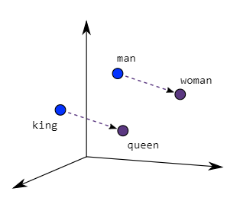
Word Embedding
Refer to models that transform terms into a numeric vectors. The meaning of the vector depends on how the models were trained.
For example, word2vec is a very famous embedding model. It transform words into vectors so that the relationship among the words are the same as the relationship among the vectors
There are multiple word embedding models that are already trained in a very large corpus that we can use directly. We will use the gensim package for this task.

Slide 9
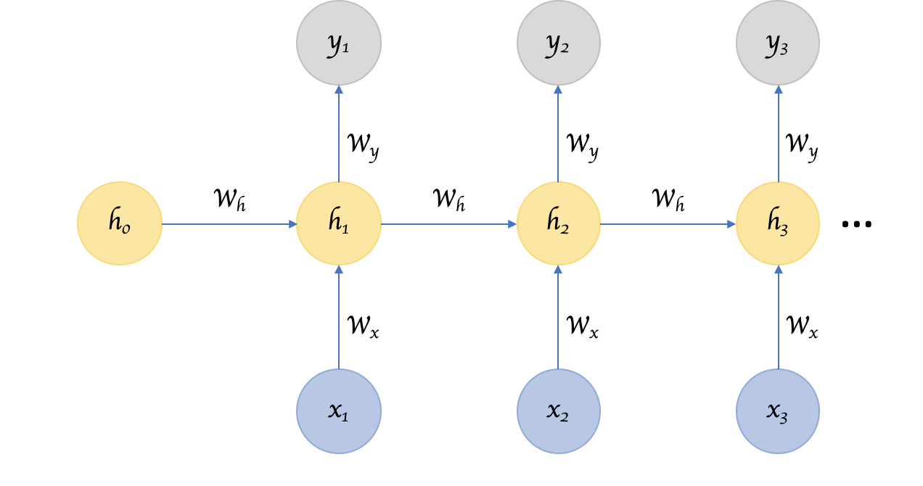
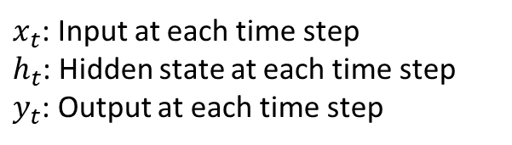
Recurrent Neural Network
Word embedding models transform a single word in a single vector. Since a document is a sequence of words, its embedded form is a sequence of vector. We refer to this type of data sequential data
The most effective way to model sequential data is to use Recurrent Neural Network (RNN). This is a special type of neural networks that are designed to handle temporal correlations in sequential data
The idea of RNN is that, at each time point, we calculate the current hidden state using the current input and the previous hidden state
In this module, we use Gated Recurrent Unit (GRU) which is a type of RNN. This can be implemented in tensorflow like CNN from the previous module
$x_{t}$: Input at each time step
$h_{t}$: Hidden state at each time step
$y_{t}$: Output at each time step

Slide 10
Universal Sentence Encoder (USE)
Is a model that is developed by Google. In short, USE transforms a document into a numeric vector
This means we do not have to worry about temporal information as in word embedding models anymore. The numeric data generated by USE can be modeled using common techniques like SVM, Neural Networks…
We also do not have to preprocess the documents. USE takes the text as-is
We can use the pretrained USE with tensorflow and tensorhub
This is the best model in this example by a large margin

Slide 11
Additional Reading
Recurrent Neural Network
https://www.ibm.com/cloud/learn/recurrent-neural-networks
https://www.tensorflow.org/guide/keras/rnn

